Slide 1
Vladislav - Progress
Conducted a comprehensive comparative analysis between K-means clustering and Expected Maximization (EM) algorithms
K-Means will be used because:
It is a hard clustering method (each data point is only assigned to 1 cluster)
With EM, clusters can overlap (one data point can belong to >1 clusters)

Slide 2
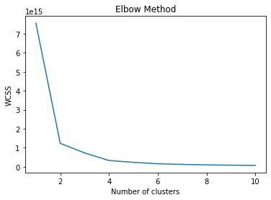
Optimal number of clusters (Elbow Method)
Calculated the within-cluster sum of squares (WCSS), which is the sum of squared distance between each point and the centroid in a cluster.
The optimal K value denoting the optimal number of clusters is 4, as at this point, the graph starts to move almost parallel to the X-axis.

Slide 3
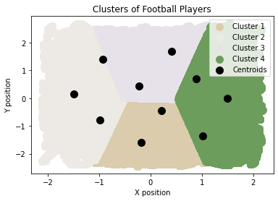
Clustering
Split the 11 outfield players into 4 clusters by means of K-means clustering
Displayed the centroids of each player

Slide 4
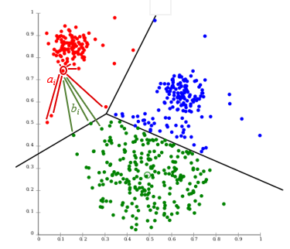
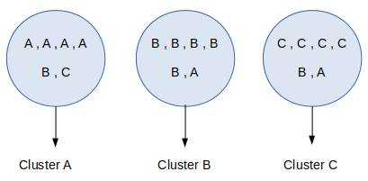
Proposed Work Evaluation
Silhouette score(to measure how similar each data point is to its own cluster compared to other clusters)
Purity

Slide 5
Current Doings
Plotting player velocities with arrows
Displaying jersey numbers
Building a pipeline for automatically classifying formations based on the players’ spatial arrangement

Slide 6

Ongoing Work
Exploratory Data Analysis
familiarization with the event data
Literature Review
obtaining domain knowledge from relevant literature
simultaneously documenting findings
Merging the Event & Tracking Data

Slide 7
Future Work
displaying jersey numbers in the demo to understand which players adopt new roles throughout the game and deviate from their typical position
combining the event data with the tracking data
code optimisation (obtaining the results is computationally expensive as a single frame is processed for approximately 1s
use of clustering techniques (most likely agglomerative clustering) to automatically classify formations

